Slide 1
Minha Palestra Modelo Pentaho Day
Marcio Junior Vieira
CEO & Data Scientist, Ambiente Livre

Slide 2
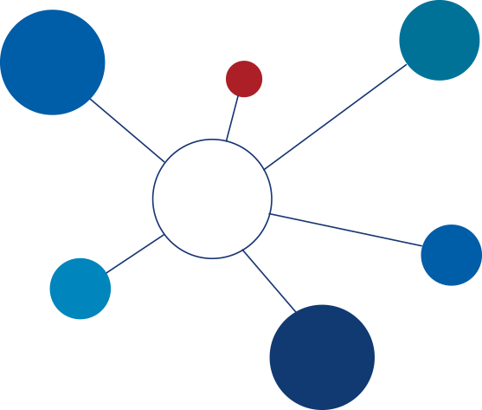
Agenda
Tópico 1
Tópico 2
Tópico 3
Tópico 4

Slide 3
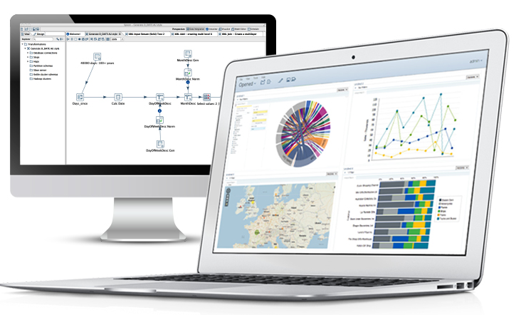
Data-driven Business
Sub Tópico 1
Full spectrum of analytics for all key roles
Embeddable, cloud-ready analytics
Broadest and deepest big data integration
Sub Tópico 2
Open, pluggable, purpose-built for the future
Sustained leadership in big data ecosystem
Sub tópico 3
Over 1,500 commercial customers
Over 10,000 production deployments
Notes:
Pentaho is an end-to-end business analytics and data integration platform. And in particular, a major area of focus for our platform has been helping customers integrate Big Data sources into their architecture and analyze that blend of traditional and emerging data. At the same time, we also provide analytics software that is highly embeddable in that they can fit seamlessly into existing applications and processes. A lot of our success in these areas has been due to both early innovation in Big Data – I believe we’ve been working with Hadoop for 5 to 6 years – as well as the open architecture and standards that our platform is built on.

Slide 4
The most powerful insights come from blending data on demand and at the source
Notes:
On-demand & at the source

Slide 5
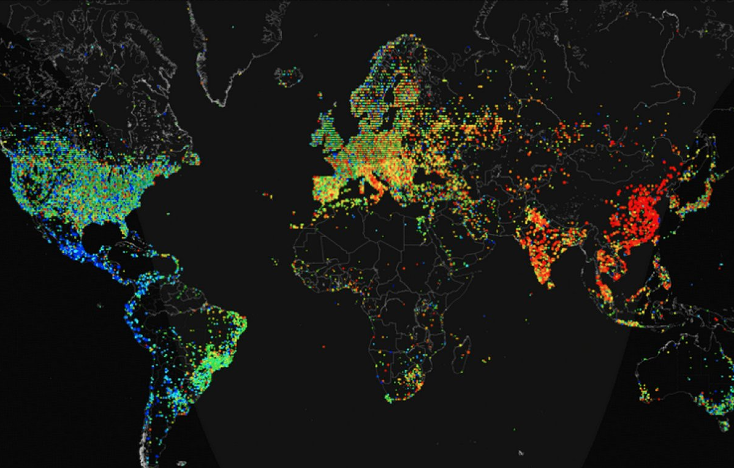
British Telecom Protecting Against Cyber Threats
Business Challenge
Launch new service to market: BT Assure Cyber, an enterprise solution for cyber security insights across many data types
Previously BT Assure Cyber could only integrate relational data sources and not big data sources
Notes:
BT
BT Assure Cyber offers comprehensive and fully integrated cyber security for large organisations with complex security needs including the UK Ministry of Defence and other corporate and government customers. UK Government Communications HQ (GCHQ) and other sources claim cyber breaches cost the global economy hundreds of billions of dollars annually.
Previously BT Assure Cyber could only integrate relational data sources, which meant that its customers’ big data sources were not being harvested to detect potential security breaches. By embedding Pentaho, event data and telemetry from a rich variety of data sources including business systems, sensors, traditional security controls and advanced detection tools are all integrated and analysed. Incidents that previously would have taken days or weeks to investigate and respond to, can now be identified and acted upon immediately.
The Disruptive Insight
BT knew that data variety and unpredictability was a mounting problem, but as an ‘Oracle shop’ with a relational heritage, they could not see an obvious way to solve it – customers all have different data landscapes depending on their individual needs, and BT must cater to all. BT started to tackle this by introducing the Hadoop framework. However, relying on Hadoop’s native, immature tools like Sqoop, Flume, Oozie, Kafka to integrate and analyse the data proved massively difficult, time-consuming and risky
Pentaho convinced BT that its big data integration and analytics platform combined with a metadata approach was the only way to reliably assimilate and blend data from so many different and unpredictable sources. BT recognised that Pentaho’s visual tools provided much faster time to value with lower risk, requiring fewer specialised development resources than native Hadoop tools.
Why the Customer Chose Pentaho
Pentaho’s ability to handle data variety and uncertainty in a range of customer scenarios was central to winning this deal. Pentaho successfully proved its viability and offered references in many other high-stakes, complex and secure customer use cases in industries like financial services and energy.
Getting the Deal Done
The single most important factor was Pentaho’s native support for Hadoop in an enterprise environment. Combined with Pentaho’s commercial flexibility to licence the platform in line with how BT charges its customers – by data volumes ingested – the ROI case finally became too compelling to resist.

Slide 6
Obrigado
Marcio Junior Vieira
marcio@ambientelivre.com.br

Slide 7
The most powerful insights come from blending data on demand and at the source
Notes:
On-demand & at the source

